Slide 1
W3C Web of Things
Talk for “Nordic Smart Cities/WoT CG”
Sebastian Kaebisch
27 November 2023

Slide 2
Outline
What is WoT?
Applying and extending web standards for IoT
Descriptive interoperability: Thing Descriptions
Finding Thing Descriptions: Discovery
Use Cases and Requirements
Recent Activity
Testfest/Plugfest
Applications
Discussion
Gaps and Future Work

Slide 3




W3C Web of Things (WoT)
W3C Working Group goal: Adapting web technologies to IoT
Already published: Thing Description (TD) metadata format
TD describes the available interactions (network API) of a Thing
New deliverables in progress, including Discovery
How does a potential user obtain the TD for a Thing?
App
App
App
App
App
App
WoT API
WoT API
WoT API
{ properties, actions, events }
MQTT
KNX
TLV
ECHONET
Bearer
EXI
HTTP
OAUTH2
WS
XML
MQTT
KNX
TLV
ECHONET
Bearer
EXI
JSON
Modbus
CBOR
OPC-UA
API Key
HTTP
OAUTH2
CBOR
WS
XML
BACnet
AMQP
JSON
Modbus
BACnet
OPC-UA
API Key
AMQP

Slide 4
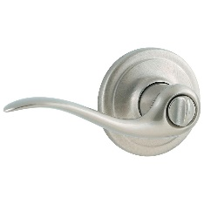
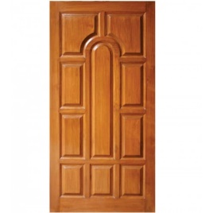
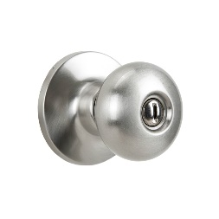
Descriptive Interoperability: TDs
WoT Architecture
Constraints
"Things" must have a TD
Must use URIs, IANA media types, etc.
Thing Description Affordances
Describes WHAT the possible choices are
Describes HOW to interact with the Thing
WoT Thing Description (TD)
{
"@context": [
"https://www.w3.org/2022/wot/td/v1.1",
{ "iot": "http://iotschema.org/" }
],
"id": "urn:dev:org:32473:1234567890",
"title": "MyLEDThing",
"description": "RGB LED torchiere",
"@type": ["Thing", "iot:Light"],
"securityDefinitions": {
"default": {"scheme": "bearer"}
},
"security": ["default"],
"properties": {
"brightness": {
"@type": ["iot:Brightness"],
"type": "integer",
"minimum": 0,
"maximum": 100,
"forms": [ ... ]
}
},
"actions": {
"fadeIn": {
...
Pull
Handle = Affordance
What?
How?
Door = Thing
Open
Turn

Slide 5
Usage Patterns Overview

Slide 6
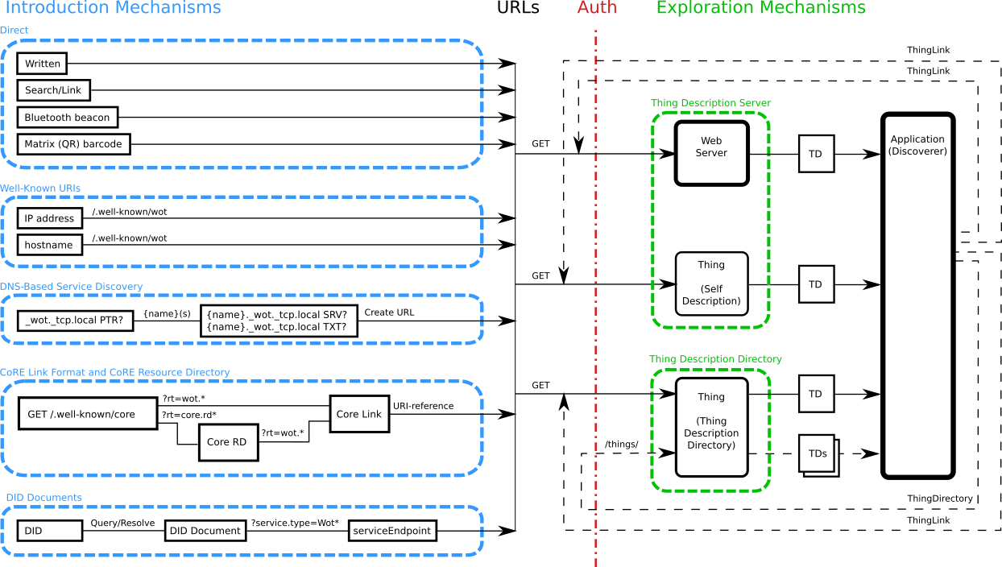
Discovery
Goal: Obtain TD of interest
Not limited to local network
Scalable to many TDs
Need to preserve privacy
Phased access:
Introduction: open
Exploration: controlled
Searchable via JSON Path, XPath, or SPARQL
Future work:
Find "nearby" Things using geospatial data

Slide 7

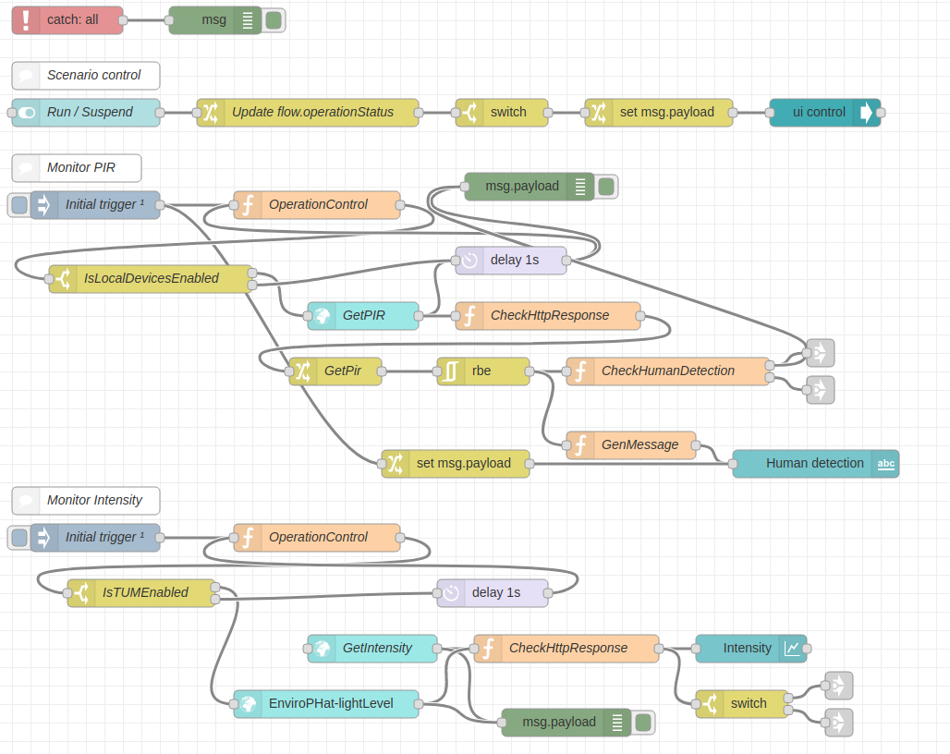
Orchestration
node-wot/Scripting API
WoTHelpers.fetch( "coap://localhost:5683/counter" ).then( async (td) => {
// using await for serial execution (note 'async' in then() of fetch())
try {
const thing = await WoT.consume(td);
console.info( "=== TD ===" );
console.info(td);
console.info( "==========" );
// read property #1
const read1 = await thing.readProperty( "count" );
console.info( "count value is" , await read1.value());
// increment property #1 (without step)
await thing.invokeAction( "increment" );
const inc1 = await thing.readProperty( "count" );
console.info( "count value after increment #1 is" , await inc1.value());
// increment property #2 (with step)
await thing.invokeAction( "increment" , {'step' : 3});
const inc2 = await thing.readProperty( "count" );
console.info( "count value after increment #2 (w/ step 3) is" , await inc2.value());
// decrement property
await thing.invokeAction( "decrement", undefined, {
formIndex: getFormIndexForDecrementWithCoAP(thing);
} );
const dec1 = await thing.readProperty( "count" );
console.info( "count value after decrement is" , await dec1.value());
} catch(err) {
console.error( "Script error:", err);
}
}).catch( (err) => { console.error( "Fetch error:", err); });
Node-RED/node-gen

Slide 8
Use Cases and Requirements
Informative Deliverable: https://github.com/w3c/wot-usecases
Purpose and Process:
Identify specific use cases
Identify application domains
Collect use cases from other W3C groups
Collect use cases from other stakeholders and SDOs
Identify usage patterns
For example, hubs, proxies, automation, etc.
Identify relevant technologies
For example, edge computing, digital twins, etc.
→ Extract common requirements to drive current and future work

Slide 9
Use Cases / Requirements Process
Spec creation (WG)
Use Case TF (IG)
Security
Shortlist
Gaps
TD
Use Case
Use Case
s
Use Case
Requirement
Use Case
Scripting
New Building Block
Discovery
System Architecture / Configuration
Profile
WoT Deliverables

Slide 10
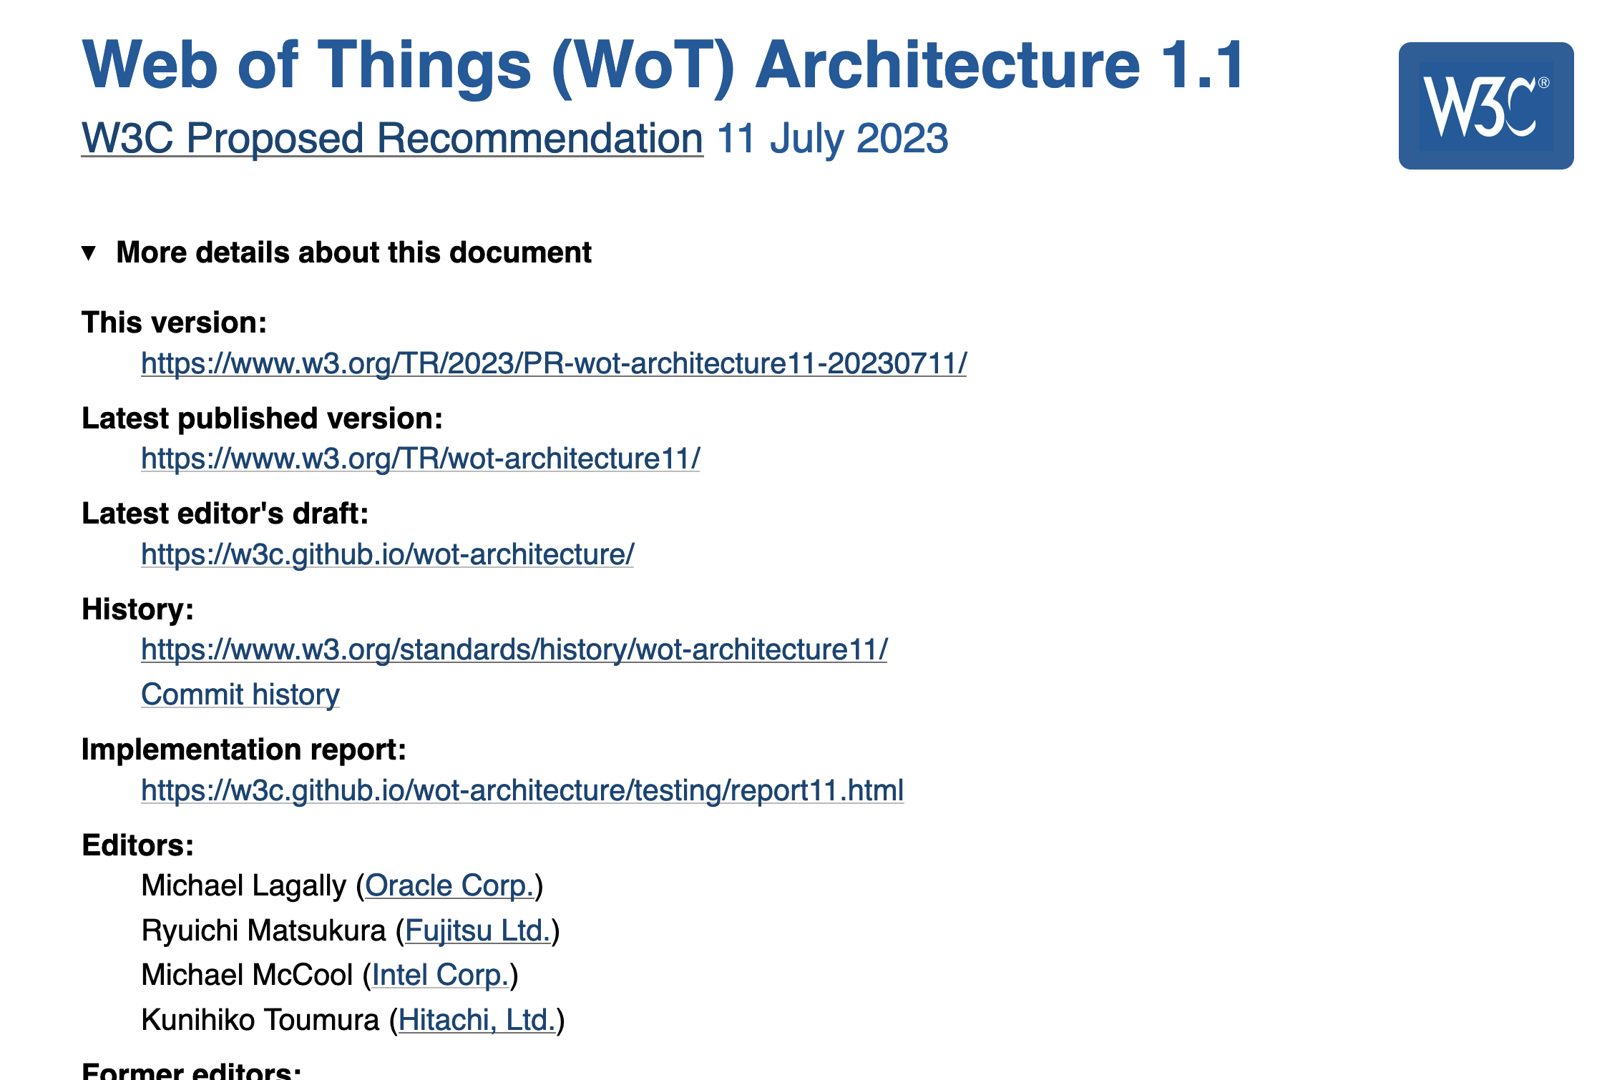
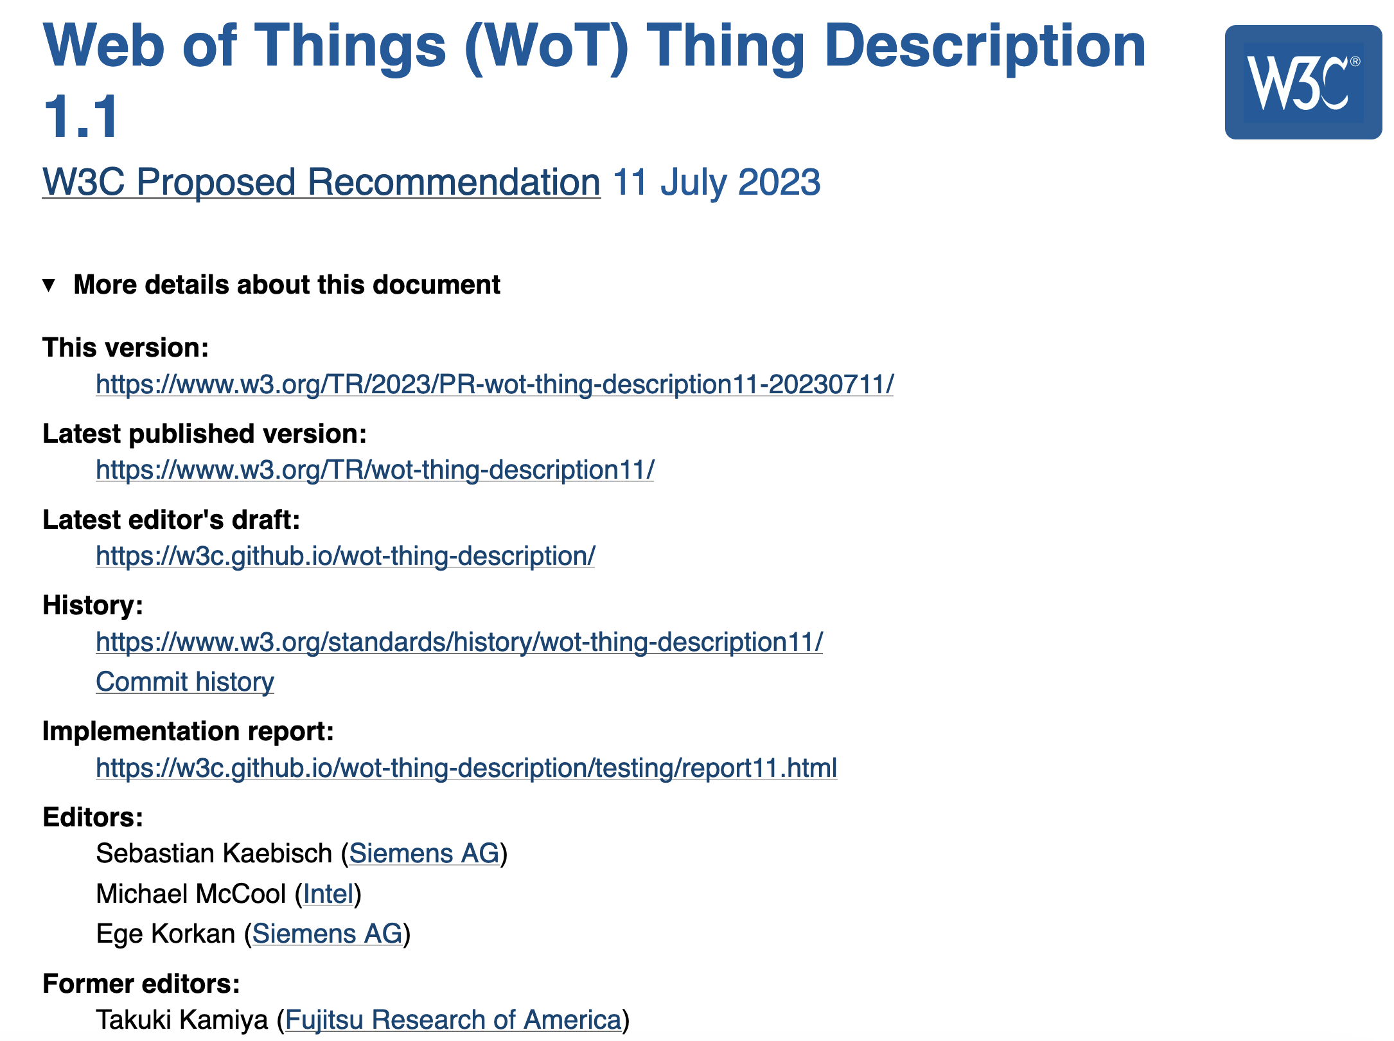
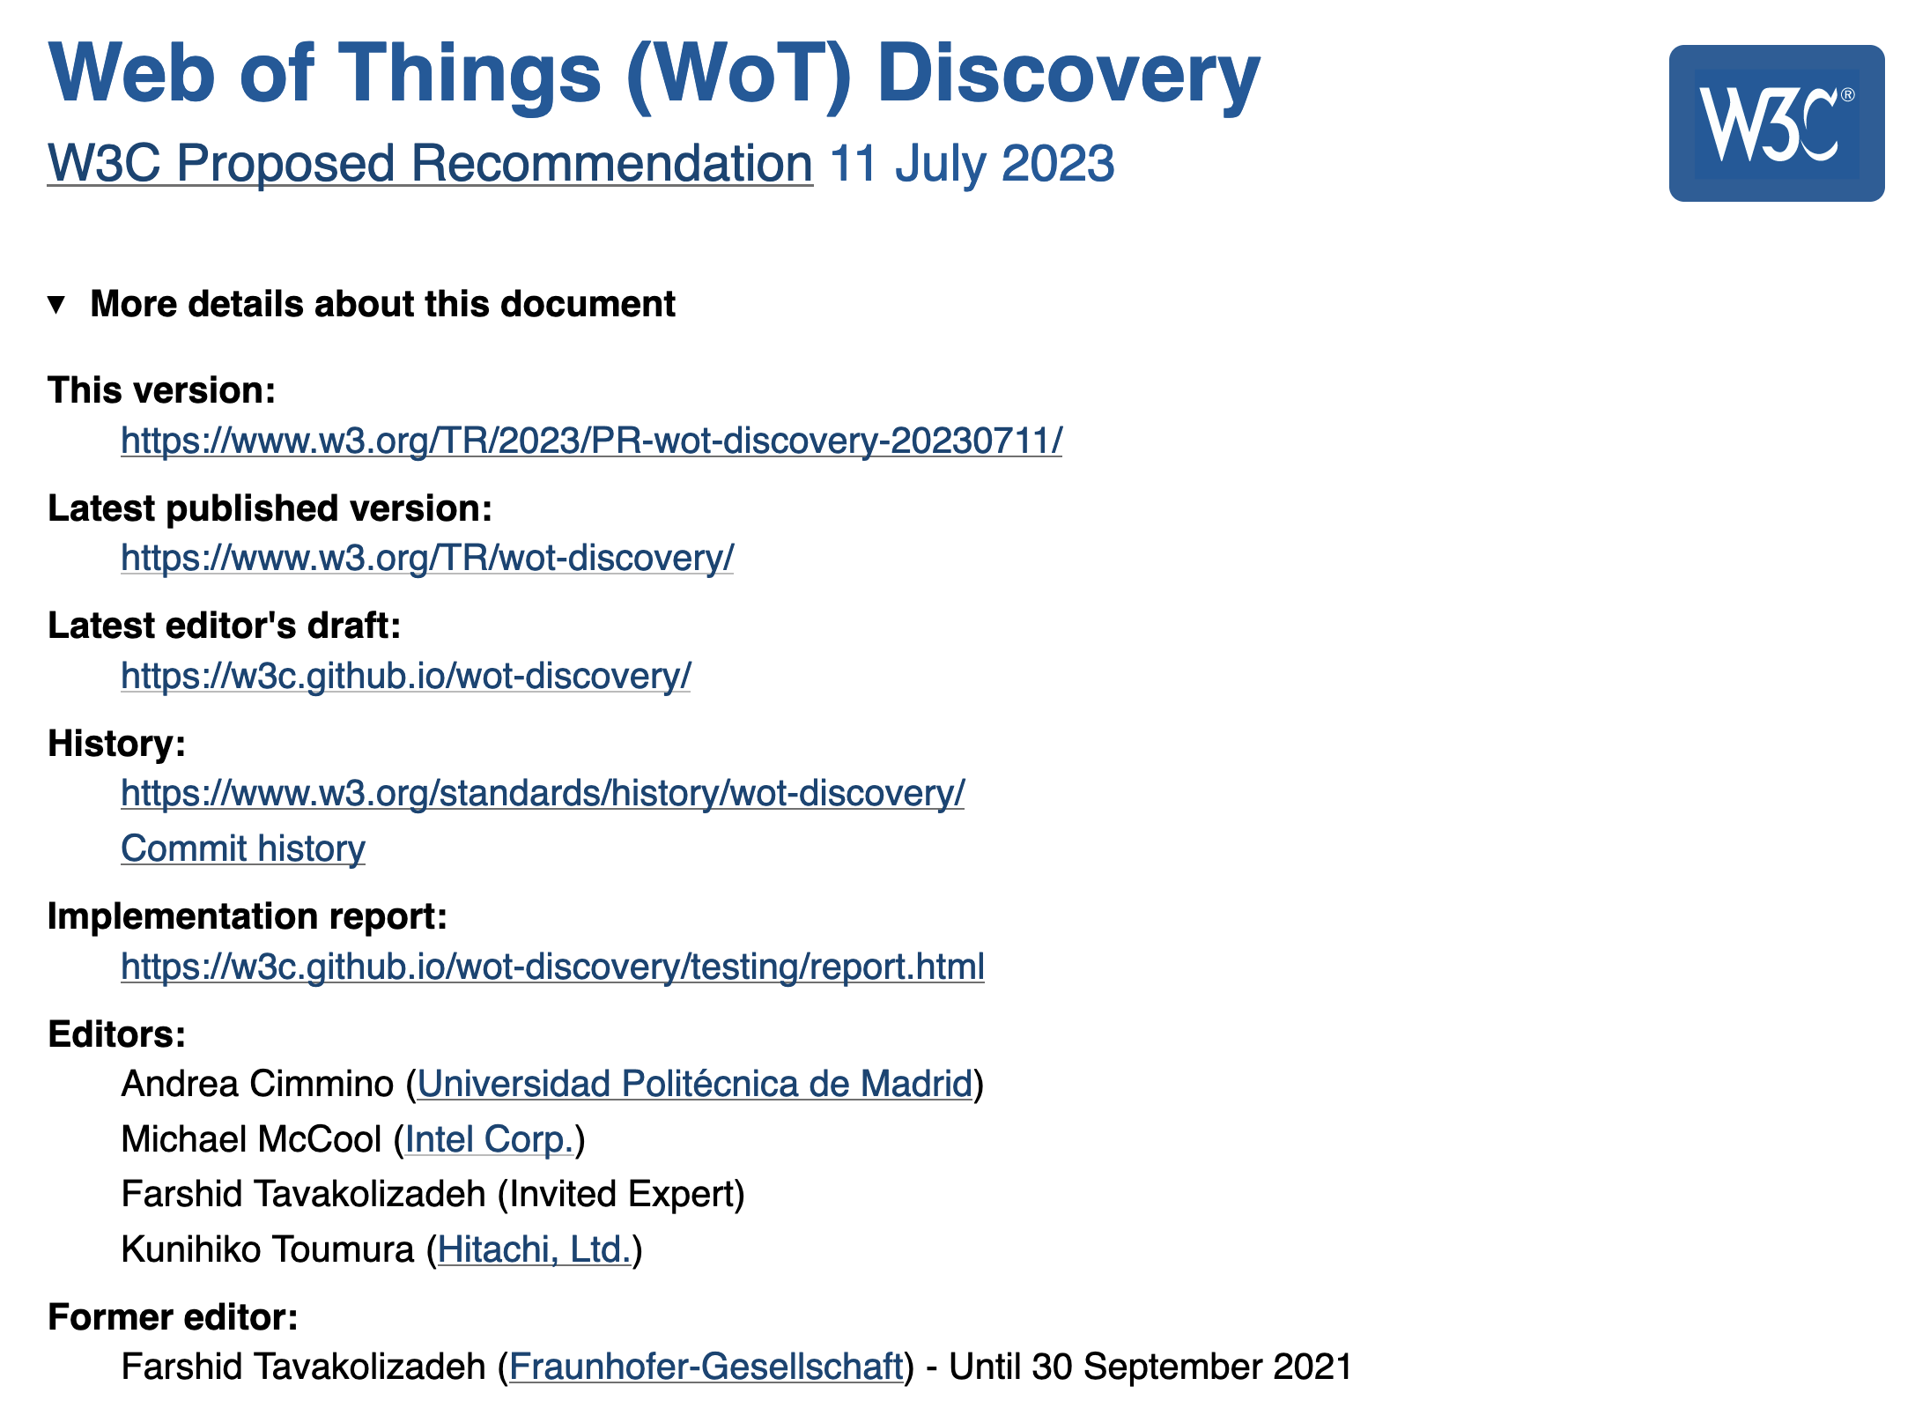
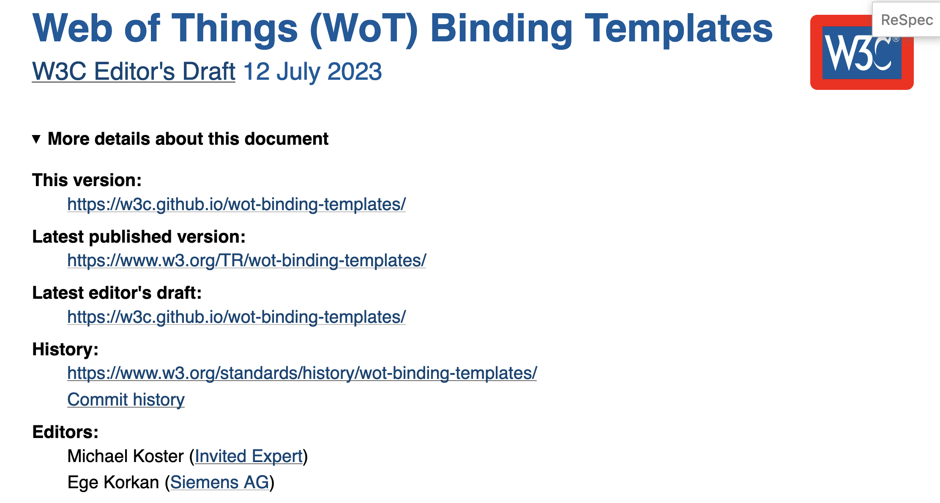
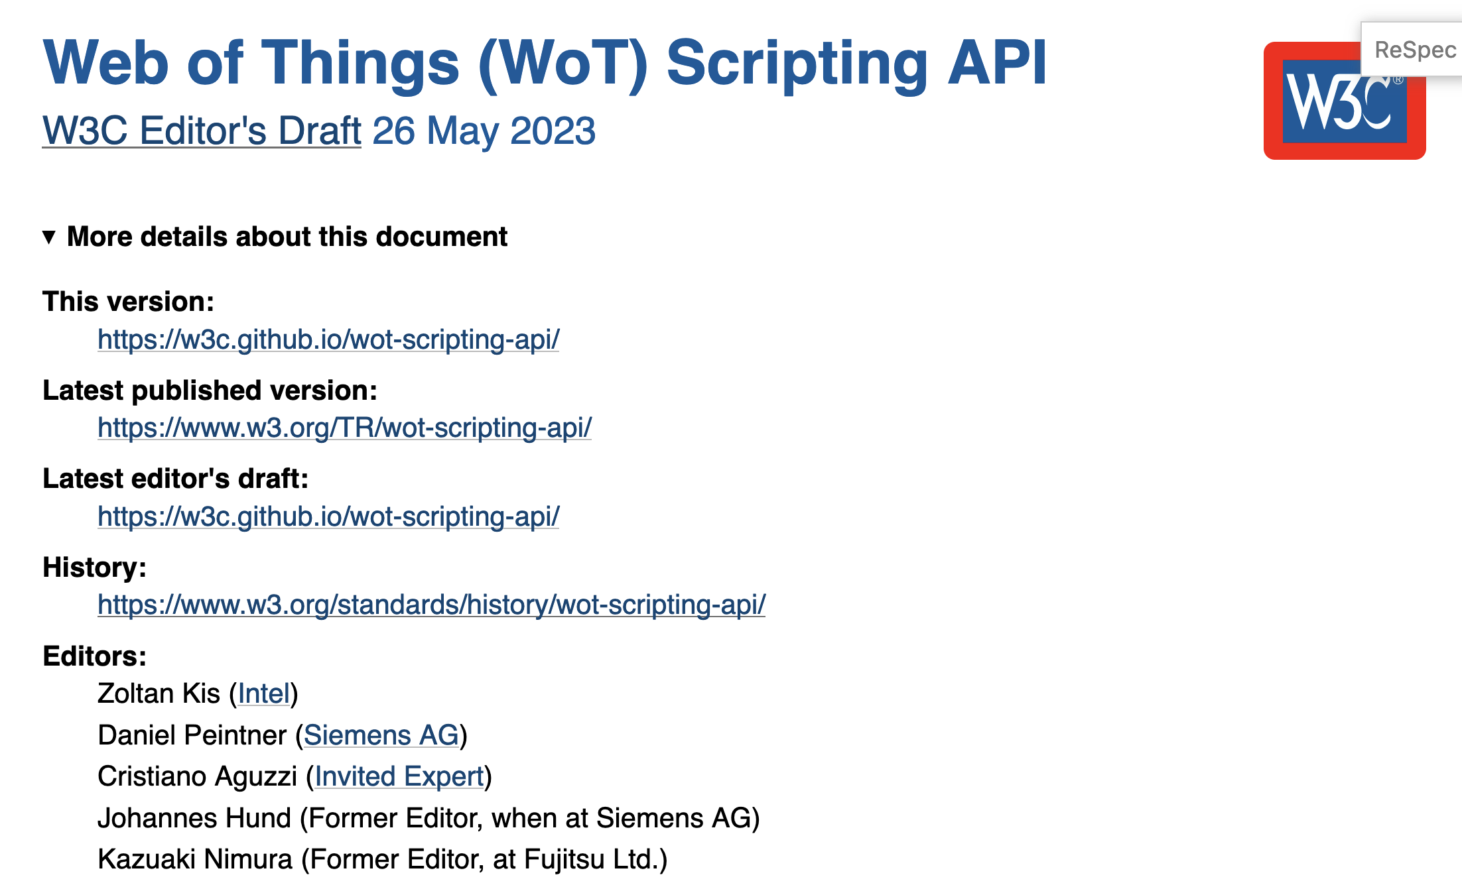
WoT New Deliverables
REC Track:
WoT Architecture 1.1
WoT Thing Description 1.1
WoT Discovery
Passed AC PR voting
Releasing RECs end Nov
Note Track:
Updated WoT Scripting API
Updated WoT Binding Template

Slide 11
Deliverables
New/Updated Normative Documents:
Architecture 1.1: https://github.com/w3c/wot-architecture
Thing Description 1.1: https://github.com/w3c/wot-thing-description
Discovery: https://github.com/w3c/wot-discovery
Profiles: https://github.com/w3c/wot-profile
New/Updated Informative Documents:
Binding Templates: https://github.com/w3c/wot-binding-templates
Scripting API: https://github.com/w3c/wot-scripting-api
Use Cases and Requirements: https://github.com/w3c/wot-usecases
Community Resources:
Web Site: https://www.w3.org/WoT/

Slide 12
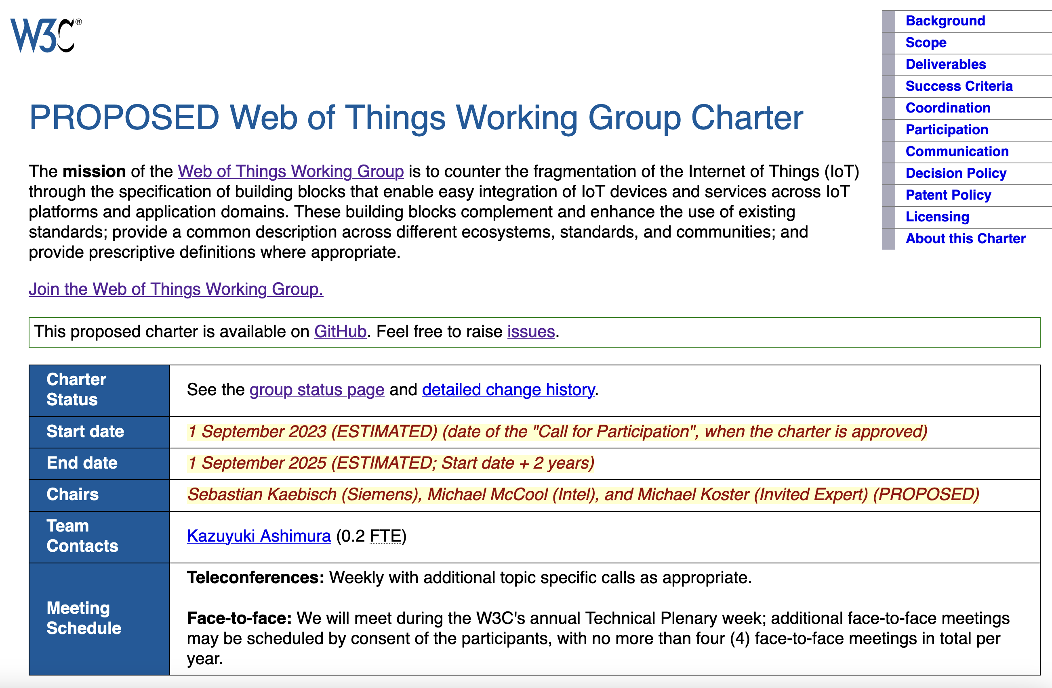
“WoT 2.0” Just Started
→ a good time to join the WG and become part of the WoT family
More details: https://www.w3.org/2023/08/wot-wg-2023-draft.html

Slide 13
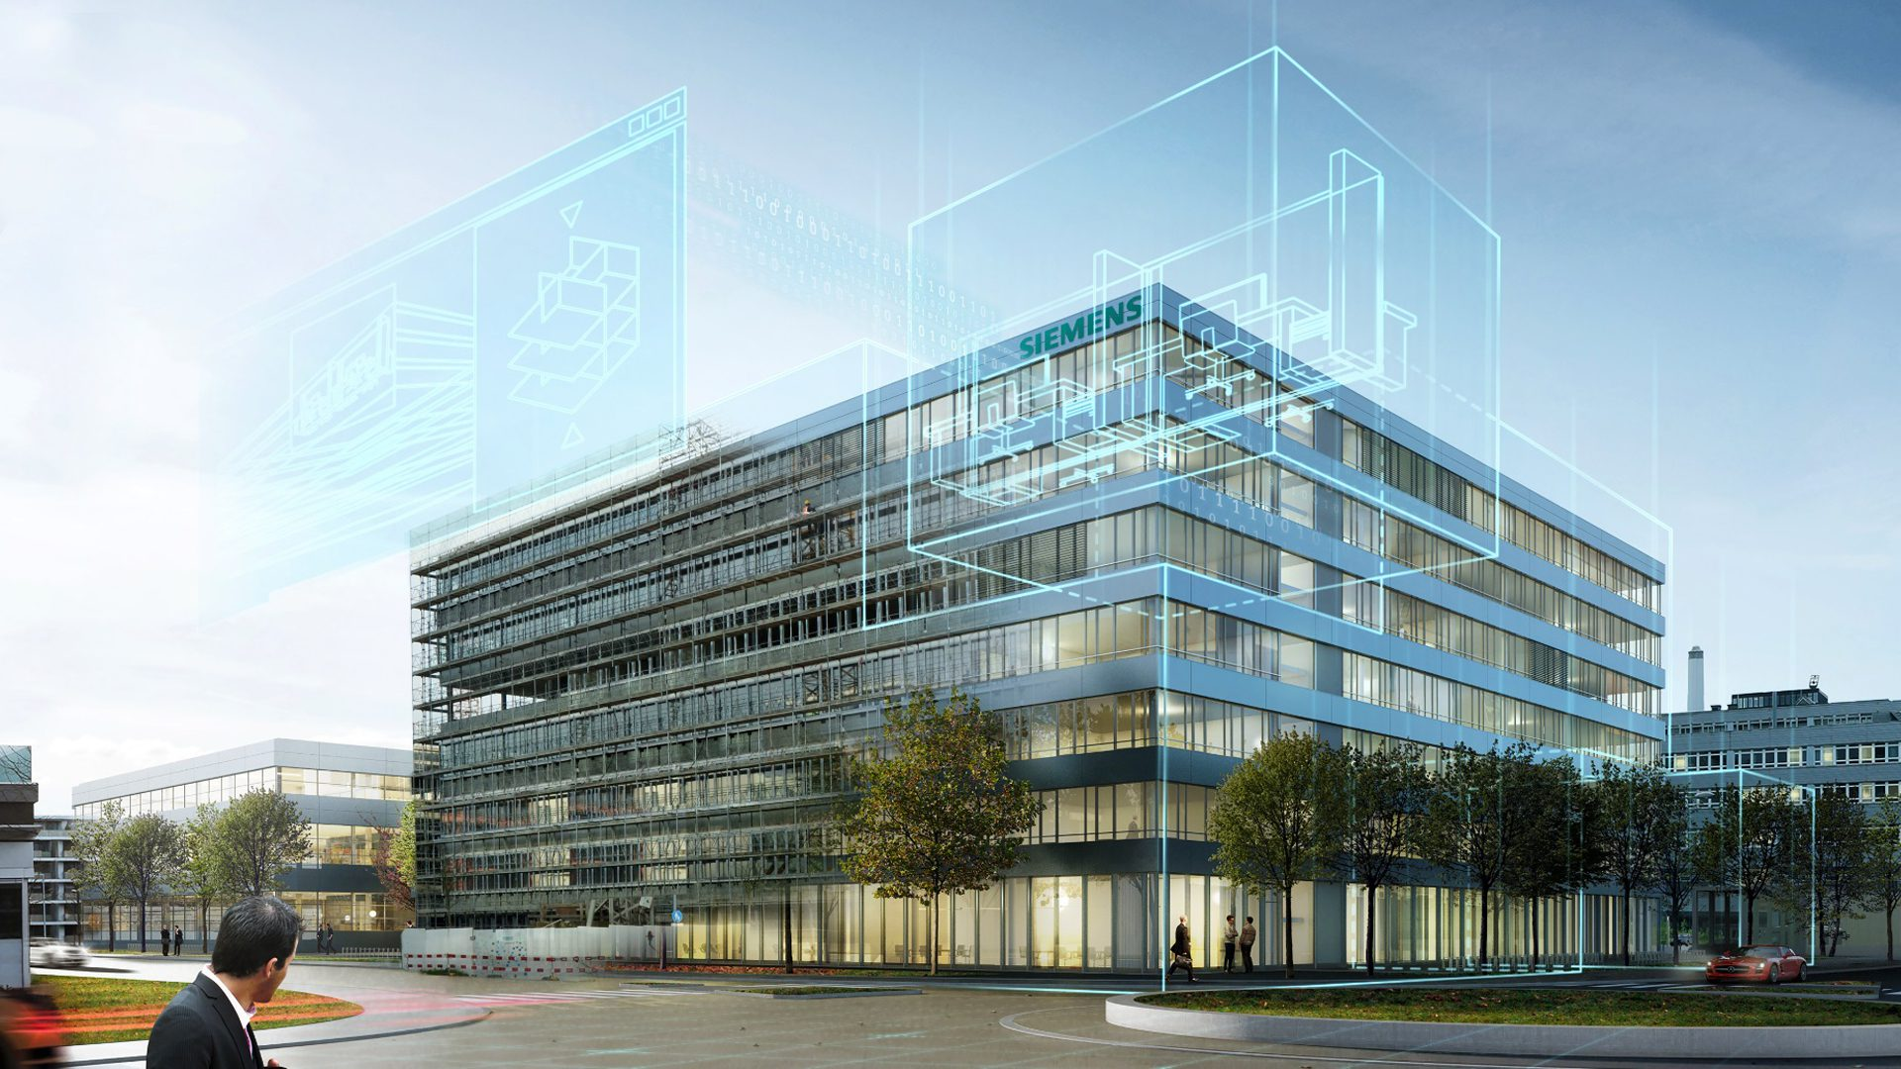
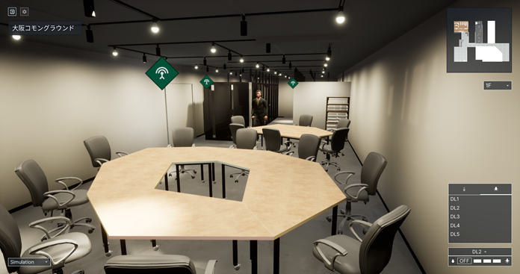


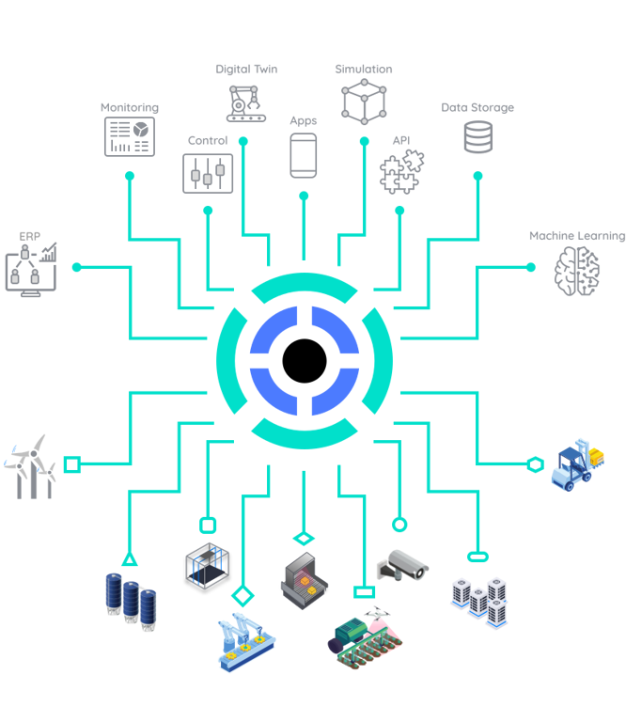
Applications
https://new.siemens.com/global/en/products/buildings/automation/desigo.html
https://www.evosoft.com/en/digitalization-offering/saywot/
Siemens
Desigo CC – BIM
Say WoT!
https://www.takenaka.co.jp/news/2021/05/02/
Takenaka Corporation
CGLL Platform - BIM
https://www.eclipse.org/ditto/2022-03-03-wot-integration.html
Bosch
Eclipse Ditto - Digital twin
https://netzo.io/
Netzo
IoT Data Hub
Dashboards

Slide 14





SDO Adoption or Under Consideration
ECHONET
Conexxus
OPC Foundation (OPC UA Web-of-Things Connectivity)
IPA Digital Architecture Design Center
Industrial Digital Twin Association (Asset Interfaces Description)

Slide 15
Discussion: Some Possible Next Steps
GIS Integration
Geospatial data and discovery
Data Management
Digital Twins and shadows
Event notifications
Data management
Security
Key provisioning and onboarding
Secure LAN access
Proxy services
Access control and ad-hoc sharing
MUDS
Accessibility
Sensory modality mapping
Textual/descriptive interfaces
Service location
Mobility services
Advanced Use Cases
Transportation
Logistics
Distributed energy management
AR visualization
Analytics integration e.g. for health and safety monitoring

Slide 16
Resources and Contacts
https://www.w3.org/WoT
Dr. Michael McCool
Principal Engineer
Intel
Technology Pathfinding
michael.mccool@intel.com
Dr. Sebastian Kaebisch
Senior Key Expert
Siemens
Technology
sebastian.kaebisch@siemens.com
Michael Koster
Invited Expert
michaeljohnkoster@gmail.com

